Slide 2
RFID Technology Comparison
“Cost” is referring to the tags, however for a single receiver/scanner combo, LF was much cheaper.

Slide 3
RFID Receiver Overview
4 Pins
VCC (+5V)
GND
/ENABLE (input)
SOUT (output)
Small size, efficient
Allows for convenient placement on the wheelchair
Low power use when scanning, and almost-zero power use when not scanning.

Slide 4
RFID Receiver Overview
/ENABLE Flag (input)
HIGH = Scanner is off, power consumption is down.
LOW = Scanning actively for keys and passing them out serially to the SOUT line
SOUT
Data is transmitted at 5V over serial communication.

Slide 5
RFID Receiver Overview
SOUT (continued)
Transfer protocol
Communication | Serial
Data bits | 8
Stop bits | 1
Parity | No
Bit Order | Least significant bit first
Transfer speed | 2400 bps
Signal | 5V TTL-level, non-inverted asynchronous serial

Slide 6
RFID Receiver Overview
SOUT (continued)
12 bytes transferred from a key read
Middle 10 bytes are ASCII characters
Start byte is 0x0A , NewLine
End byte is 0x0D, Carriage Return

Slide 7
RFID Receiver Overview
LED
Along with the RFID lock/unlock system will be a simple LED that changes colors based on the current state:
LED Color | Meaning | Occurs When
GREEN | Idle state - Not searching | /ENABLE port is either HIGH or disconnected
RED | Actively searching for RFID key | /ENABLE is LOW
Blank | No power | VCC is low or disconnected

Slide 8
RFID Receiver Overview
DC Characteristics of RFID Receiver

Slide 9
RFID Receiver Overview
Maximum Ratings of RFID Receiver
They are well within the conditions of most human-populated areas of the world

Slide 10
RFID Tag Overview
Passive Key used with Low Frequency RFID technology.
Reliable
Has no battery requirement, should function well beyond any user’s needs.

Slide 11
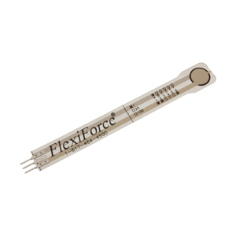
FlexiForce A204 Sensor
Specifications
Thickness | 0.208 mm
Length | 197 mm
Width | 14 mm
Sensing Area | 9.53 mm diameter
Connector | 3-pin Male Square Pin
Substrate | Polyester
Pin Spacing | 2.54 mm
Linearity Error | < ±3%
Repeatability | < ±2.5% of full scale
Hysteresis | < ±4.5% of full scale
Drift | < 5% per logarithmic time scale
Response Time | < 5 microseconds
Operating Temperatures | -40°C – 60°C
Force Ranges | 4.4 N, 110 N, 440 N
Temperature Sensitivity | Output variance of 0.2% per degree
197 mm
14 mm

Slide 12
FlexiForce A204 Sensor
Specifications
Thickness | 0.208 mm
Length | 56.8 mm
Width | 31.8 mm
Sensing Area | 25.4 mm diameter
Connector | 2-pin male square pin
Substrate | Polyester
Pin Spacing | 2.54 mm
Linearity Error | < ±3%
Repeatability | < ±2.5% of full scale
Hysteresis | < ±4.5% of full scale
Drift | < 5% per logarithmic time scale
Response Time | < 5 microseconds
Operating Temperatures | -40°F – 140°F
Force Ranges | 0 – 1 lb, 0 – 25 lb, 0 – 100 lb
Temperature Sensitivity | Output variance of 0.2% per degree
31.8 mm
56.8 mm

Slide 14
Locking Mechanism
Brakes
Motor
Driver

Slide 15
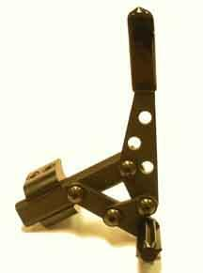
Standard/Manual Brake Locks
Replacing

Slide 16
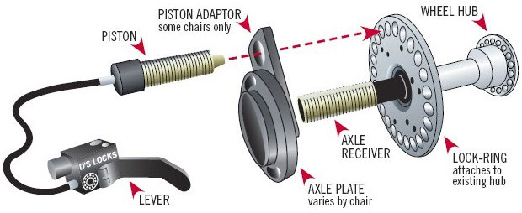
Piston Driven Actuator
Backup plan/option

Slide 17
Cable Disc Brakes
Product Specifications:
Mechanical two piece forged aluminum calipers
Tri-align caliper positioning
Sintered pads
Dual knob pad adjustment
Cable disc brakes
G2 CleanSweep rotors
Weighs only 329 grams
Advantages
Durable
Light weight
Cost effective
Low maintenance
Simple installation
Tremendous braking power
Reliable in all weather conditions

Slide 18
Motor for Locking Mechanism
Servo vs Stepper
Servo pwm

Slide 19
Geared Bipolar Stepper Motor
Specifications
Motor Type | Bipolar Stepper
Step Angle | 0.018°
Step Accuracy | 5%
Holding Torque | 48 kg*cm
Rated Torque | 48 kg*cm
Maximum Torque | 250 kg*cm
Recommended Voltage | 12 V DC
Rated Current | 1.7 A
Coil Resistance | 1.7 O
Shaft Diameter | 8 mm
Weight | 568 g
Number of Leads | 4
Gearbox Type | Planetary
Gear Ratio | 99.5:1
Maximum Strength of Gears | 48 kg*cm
Shaft Maximum Axial Load | 49.1 N
Shaft Maximum Radial Load | 98.1 N

Slide 20
L293 H-Bridge motor driver
Specifications
Wide Supply-Voltage Range | 4.5 V to 36 V
Maximum Output Voltage | 36 V
Maximum Switching Voltage | 36 V
Peak Output Current | 2 A
Drivers Per Package | 4
Input Compatibility | TTL
Delay Time | 800 ns
Pin Package | 16PDIP
Price | $2.20
Drive Currents | Bidirectional
Output Current Per Channel | 1 A
Peak Output Current Per Channel | 2 A
Maximum Junction Temperature | 150°C
Storage Temperature Range | -65° – 150°C

Slide 21
L298 – Second/Backup Option

Slide 22
Budget
Item | Unit Price | Quantity | Total Cost
Invacare Veranda Manual Wheelchair | $99 | 1 | $99
A204 FlexiForce Sensor | $19.50 | 4 | $78
Linx Technologies RXM-GPS-R4-T | $21.48 | 1 | $21.48
ADH8066 GSM Module | $49.95 | 1 | $49.95
Quad Band GSM/GPRS 7888 GSM Module | $39.95 | 1 | $39.95
SIM300 GPRS Development Board w Antenna | $31.20 | 1 | $31.20
Texas Instruments MSP-EXP430G2 | $10.99 | 1 | $10.99
Texas Instruments MSP430G2553IN20 | $2.43 | 1 | $2.43
Linx Technologies EVM-GPS-R4 | $27.73 | 1 | $27.73
Antenna GPS Embedded SMA | $11.95 | 1 | $11.95
20-PIN DIP Socket | $0.75 | 1 | $0.75
SMA Connector | $11.90 | 1 | $11.90
Basic 20x4 Character LCD Screen | $17.95 | 1 | $17.95
12v Lithium Ion Rechargeable Battery | $89.99 | 2 | $179.98
UA7815 Positive Voltage Regulator | $0.66 | 2 | $1.32
DC Power Connectors | $1.26 | 2 | $2.52
RFID Card Reader Module | $42.99 | 1 | $42.99
RFID 54mm x 85mm Rectangle Tag | $2.50 | 1 | $2.50
RFID Blue Eye Key Fob Tag | $1.99 | 1 | $1.99
RFID 50mm Round Tag | $1.99 | 1 | $1.99
Avid BB7 Mechanical Disc Brake | $51 | 2 | $102
Geared Bipolar Stepper Motor | $45 | 1 | $45
L293 H-Bridge motor driver | $3.50 | 1 | $3.50
Total |  |  | $787.07

Slide 23
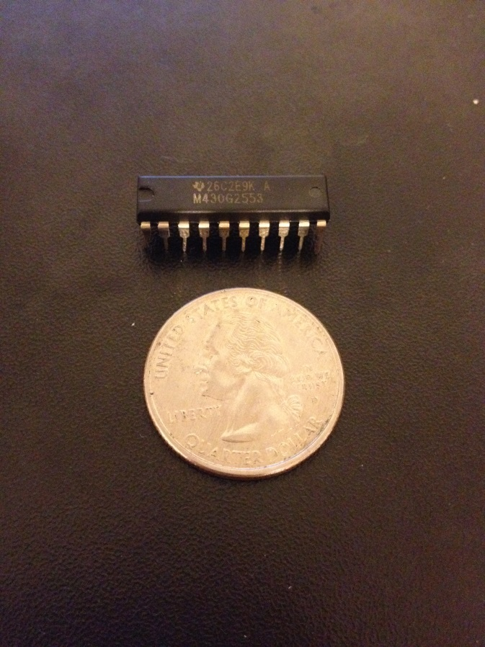
MSP430
Contains all code for the system
Low power: 1.8 to 3.6 volts
5 power saving modes
Low cost: $2.43
Supports UART and USCI

Slide 24
GSM Module
Low power: 3.4V – 4.5V (Normally 4.0V)
Current consumption as low as 2.5mA
Has GPRS capabilities
AT Commands used
Affordable: $31.20
M2M data plan required

Slide 25
GSM Module Task
GPS coordinates, battery levels, and error/status messages will be sent
SMS message and E-mails
Message sent when event is triggered
When the wheelchair is moved while it is locked
When battery life hits 20% and then again at 10%
When failure in component

Slide 26
GSM activity diagram
Connect to network
If data is received then sends message
Enters low power mode until woken up for data to be sent

Slide 27
GPS Module
Fast TTFF: 32 seconds from cold start
Low power: 3.3v and 56 mA
Supports up to 48 channels
Uses NMEA 0183 protocol
Small and compact
Affordable: $21.48

Slide 28
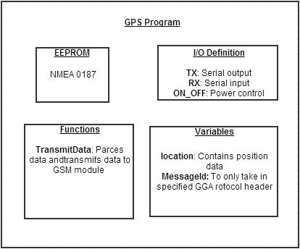
GPS Module Tasks
Acquire NMEA 0187 protocol
GPS coordinate location is parsed
Data is sent to GSM module

Slide 29
GPS Activity Diagram
GPS Coordinate acquired
Sends data to microprocessor
Enters low power mode until
Timer timeout
Event is triggered

Slide 30
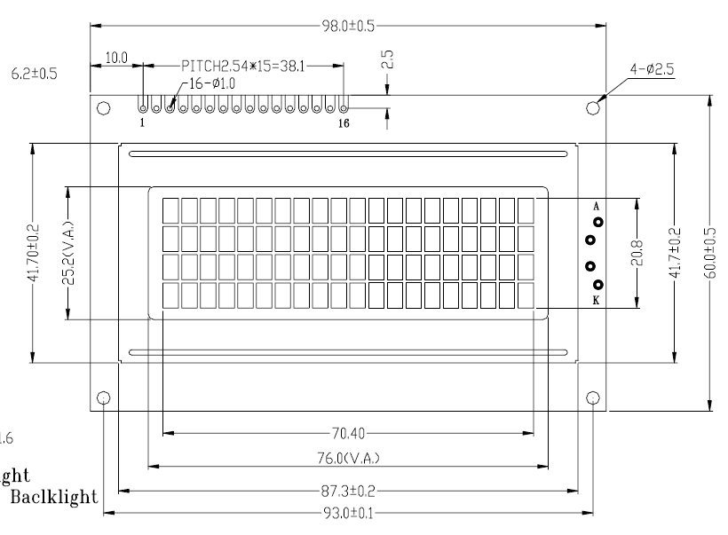
LCD SCREEN
Character type
Low Cost
Not graphical difficult to Program
Best type based on Project
20 X 4

Slide 31
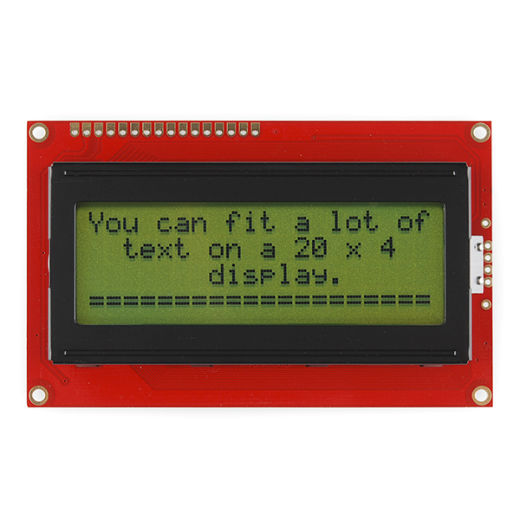
LCD Screen Function
Provide power levels from circuit
Displays if locking mechanism is Locked/ Unlocked

Slide 32
LCD DIAGRAM

Slide 33
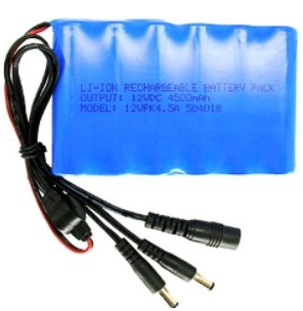
Lithium- Ion Battery
Excellent Time Durability
Excellent Life Durability
High Charge efficiency
Very Cost Effective
12.6V

Slide 34
Battery Comparison

Slide 35
Power

Slide 36
Printed Circuit Board

